Slide 1
Creating a Chatbot

Slide 2
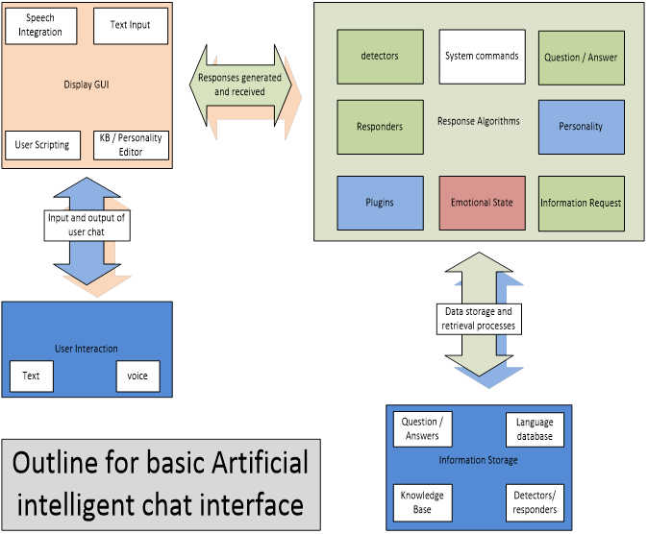

Slide 3
Building your chatbot
Building a Chat interface for your chatbot consists of four main elements:
Input text: this allows the user to send text or input conversation to the chatbot, this interface could also be a voice input device, or character recognition or even gesture input, but the main thing is to have an input device.
Text-Input button: This allows you to send input to the algorithms / Program, to create an appropriate response.
Output text: This is Where responses are displayed – this could also be a voice interface and is not limited to a button interface, but most assuredly an output medium is required:
Optional: A character avatar, This is a representation of your chatbot although not necessary but, can definitely add user friendliness to the chatbot
Again these interfaces to the user and to the chatbot medium are only limited but the capabilities desired and requirements of the project. There are major advancements currently in input and output mediums, with various API’s available to utilize such interfaces, these are only limited by programmer ability and cost factors.

